Slide 1




2020 Annual Conference of the African Great Lakes Stakeholders Network:
Lake Turkana Advisory Group
Dr Kevin Obiero, Centre Director, KMFRI
Building the Foundation for Long-Term Scientific Inquiry and Networks
December 10th, Virtual
Notes:
1

Slide 2
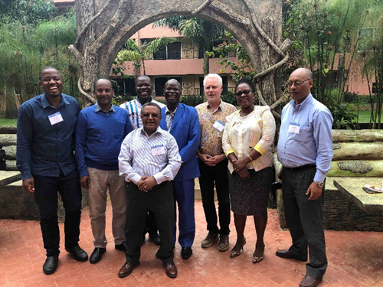
LTuAG founding, membership and composition)
LTuAG founded during the 1st African Great Lakes Stakeholder Workshop, held in Entebbe, Uganda, November 5-7, 2019
Eight (8) members drawn from research and academic institutions
2

Slide 3
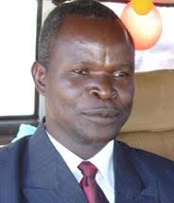
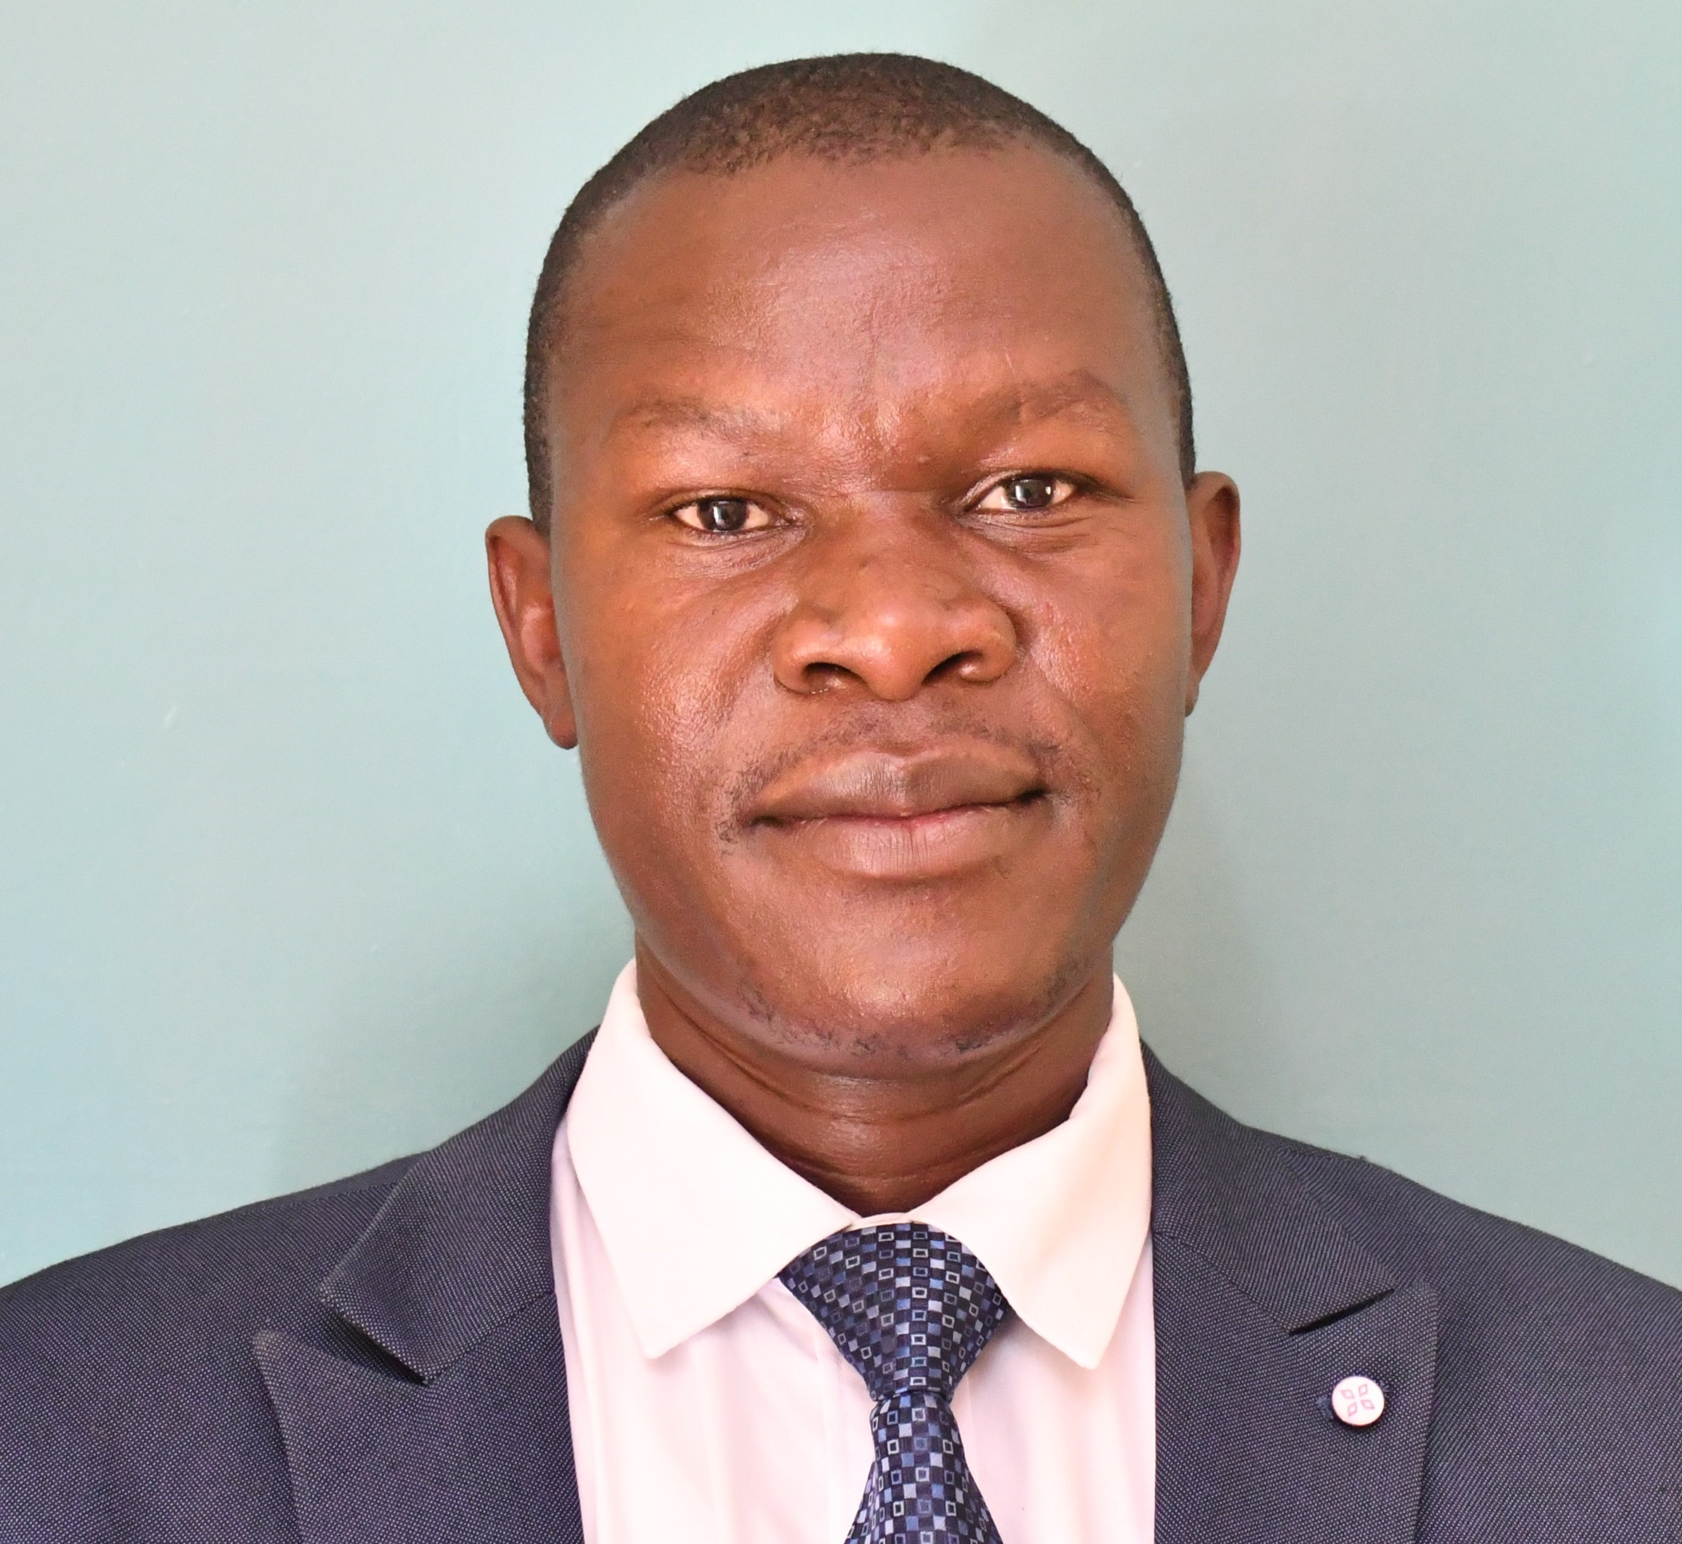
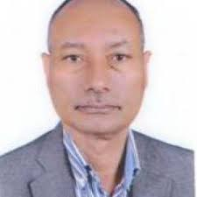
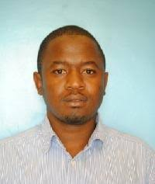
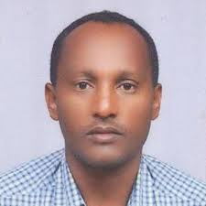
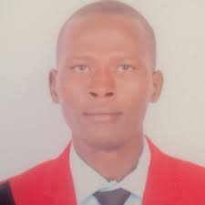

                Leadership framework
Other co-opted members
1. Tekle Olbamo, University, Ethiopia
2. Yeneneh Teke, Advisor, Ethiopia
Mr. John Malala
Co-Lead
KMFRI Lake Turkana Station, Kenya
Dr. Kevin Obiero
Group Coordinator
KMFRI Sangoro, Kenya
Prof. Abebe Getahun
Co-Lead
Addis Ababa University, Ethiopia
Mr. James L. Keyombe
Member
KMFRI Lake Turkana Station, Kenya
Prof. Mulugeta Wakjira
Member
Jimma University, Ethiopia
Mr. Evans Lomodei
Member
Turkana University College, Kenya
Prof. Jeppe Kolding
Advisor
University of Bergen, Norway

Slide 4
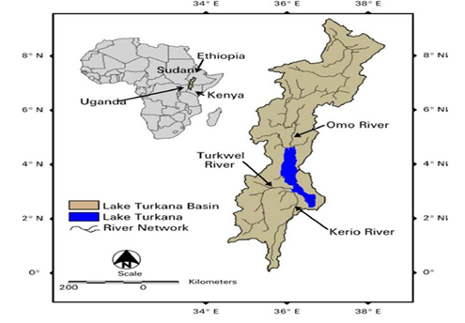
Geographical location of Lake Turkana Basin

Slide 5
Lake Turkana (Key Characteristics)
Characteristics | Measure
Position | 3°29′N , 36°17′E
Altitude (m above mean sea level) | 365 ± 5
Catchment area (Km) | 130,860 (48% in Ethiopia)
Surface Area (Km²) | 7,560
Maximum length, North-South (km) | 265
Maximum width, East-West (km) | 32
Mean width (km) | 31
Maximum depth (m) | 114
Mean depth (m) | 31
Volume (km³) | 237.4
Precipitation (mmyr ⁻¹) | < 200
Annual fluctuations in lake level (m) | 1 – 1.5

Slide 6
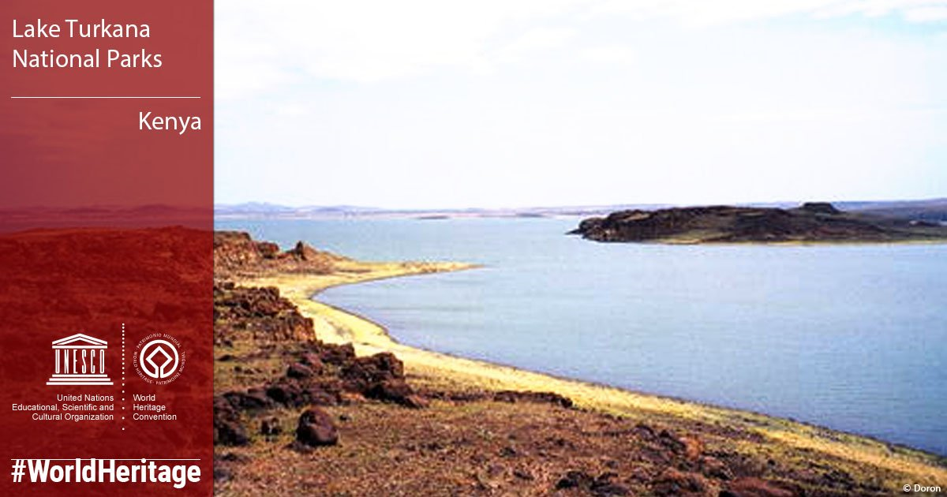
Why the focus on Lake Turkana Basin?
Lake Turkana region is “Cradle of Mankind”, but least studied of the African Great Lakes;
The Omo-Turkana basin hosts at least 79 valid native fish species referable to 44 genera, 22 families and 9 orders (Wakjira & Getahun, 2017);
Lake Turkana supports over 350 native and migratory bird species “Important Birdlife Area” (UNESCO, 2014);
The lake and river host the world’s largest remaining population of Nile crocodile (Crocodylus niloticus) (UNESCO, 2014)
Four species of endemic reptiles and endemic Turkana mud turtle (Pelusios broadleyi, vulnerable)

Slide 7
Advisory group purpose on the lake
The LTuAG’s priority is to harmonize research priorities to positively influence policy and management of the lake’s resources through sound science:
Lake wide monitoring on the lake’s status (Hydrology/Limnology, Stock Assessment)
Identify innovative ways for data collection e.g. the use of remotely sensed data, catch monitoring program
Develop protocols for standardized data collection for both countries
Planned set up of a small research Centre at Ethiopia’s side of the lake to ease the operations that have been planned for.
Social and Economic impact studies on people’s livelihoods

Slide 8
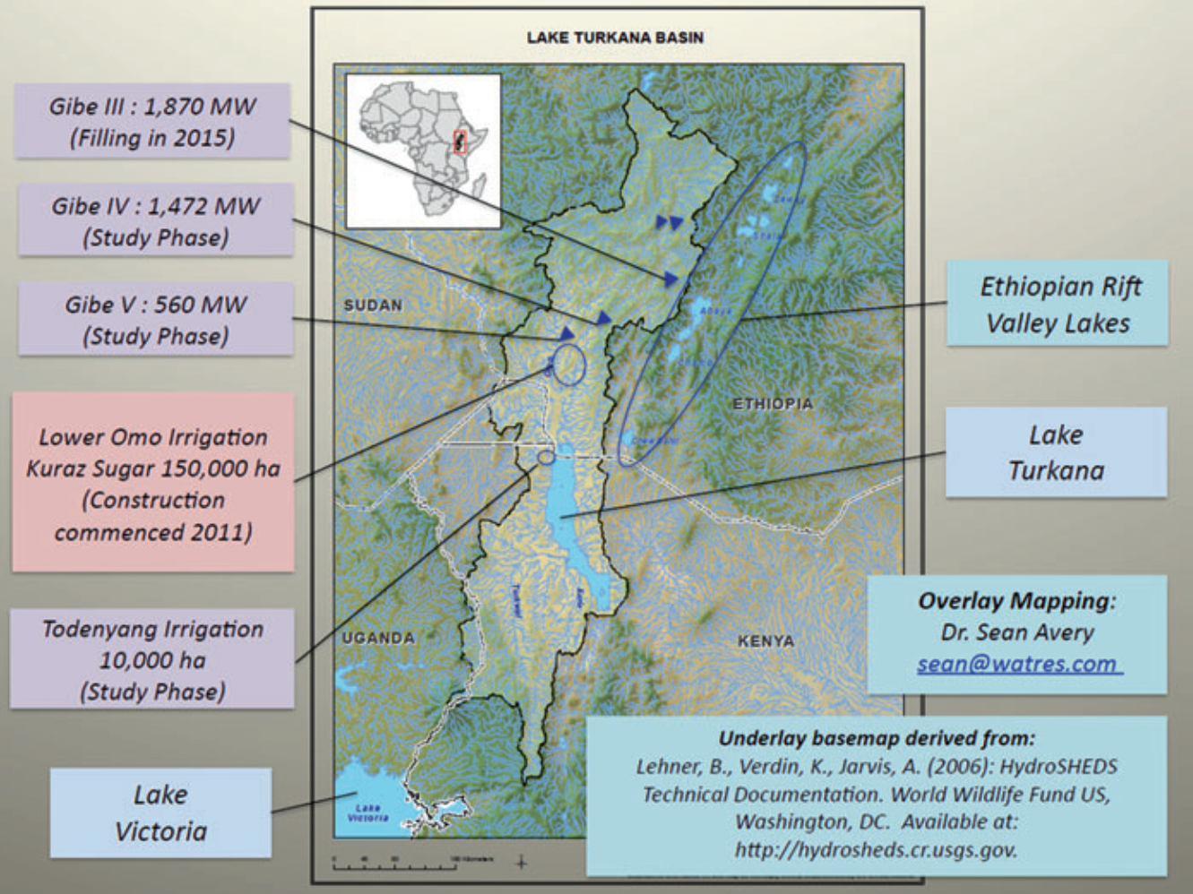
Key Ecological Threats to the Omo-Turkana Basin

Slide 9
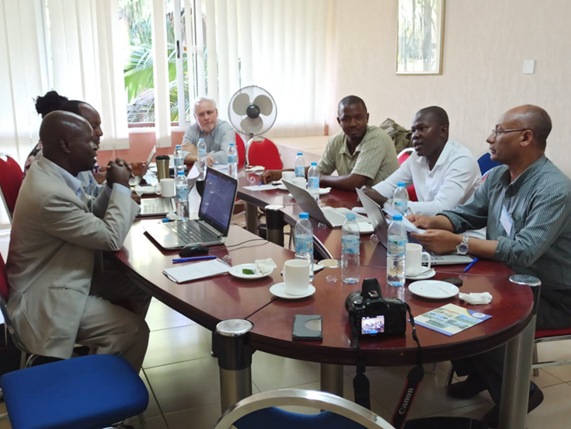
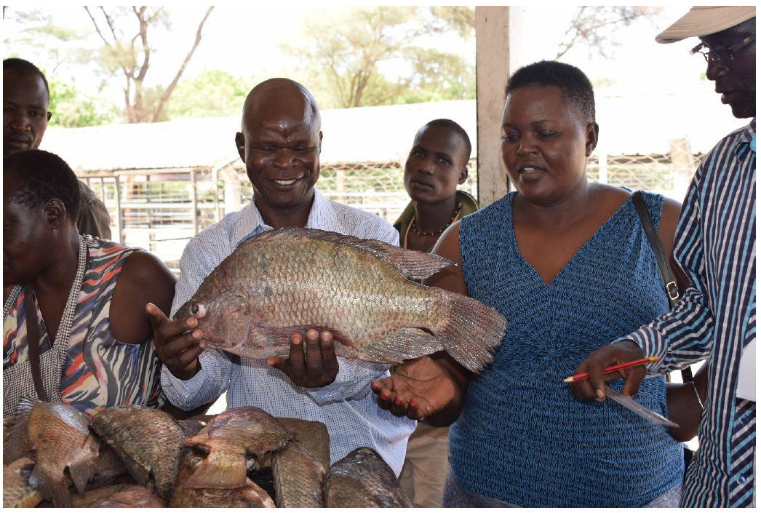
Milestones: Highlights and successes of 2020
Monthly virtual meetings and IAGLR Virtual Conference
Mapping of potential collaborators, funders and supporters
Development of Concept Note for Establishment of Research Station in the Omo River Delta (LLO Team)
Obtained 2ha Land in Omorate Town offered by Jinka University for the Research Station. Structural Designs and Mobilization of funds
Ongoing studies on limnology (major pollution points, post-harvest loss assessment, impact of gillnet fishery and update biological data)
Mapping of priority issues on lake

Slide 10
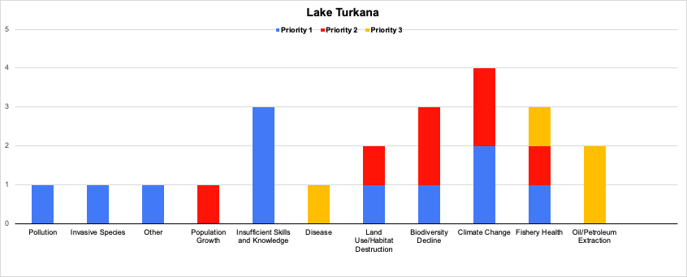
Top research priorities on Lake Turkana
Climate change
Insufficient Skills and Knowledge
Biodiversity Decline
Fishery Health
Land Use/Habitat Destruction

Slide 11
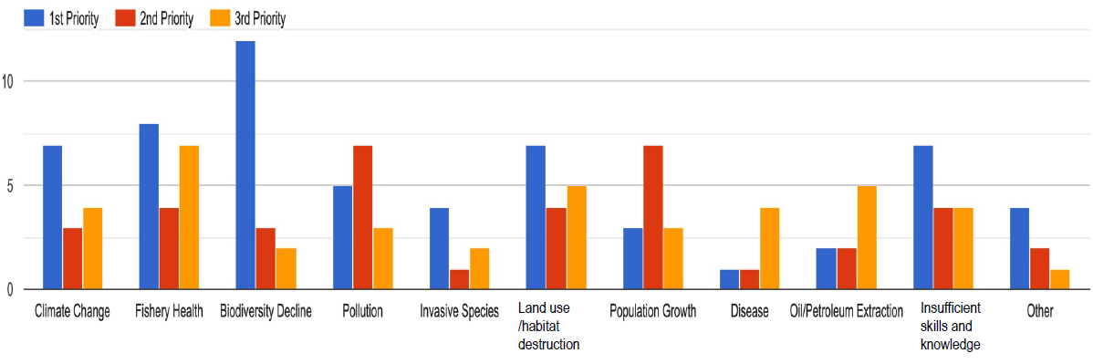
Top research priorities on the African Great lakes
The graph below shows the rankings for issues for all seven lakes by total survey participants (n=33).
Fishery Health = 19
Biodiversity Decline = 17
Land Use/Habitat Destruction = 16
Insufficient Skills and Knowledge = 15
Pollution = 15
Climate Change = 14
7. Population Growth = 13
8. Invasive Species = 7
9. Oil/Petroleum Extraction = 7
10. Other = 7
11. Disease = 6

Slide 12
Recommended Solutions to address the issues
Collaborative, multidisciplinary quarterly data collection on the lake
Lake Turkana can serve as good example of future climatic scenarios as it has by far the most extreme environmental history already.
Establishing a new research station at Omorate in Ethiopia and upgrade the research station on Kenyan side of the lake
Lake wide stock assessment, frame and acoustic surveys and limnological studies
Limnological studies including water quality, behavioural studies with focus on migratory fish spp.,
Reduction of post harvest fish losses is also an area of concern.

Slide 13
Best resource investment for this lake/group
We require full-fledged partnership
  To assist to establish of the research station
    Develop joint proposal and raise funds
  Conduct comprehensive studies related to the lake and the Omo River
  Generate pertinent data that would help policy makers for better management decision and ensure the lake’s sustainability and its resources.
We expect fostered and sustained collaboration with the University of Minnesota Large Lakes Observatory (UM-LLO) and other partners.

Slide 14
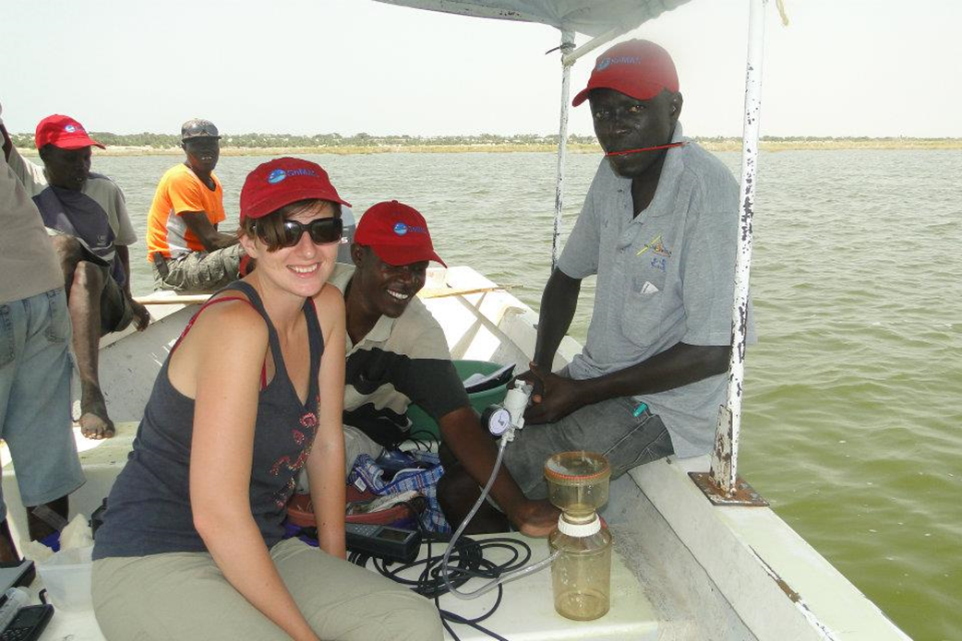
Roadmap (Plans-2021 and beyond, opportunities)
Prioritize and harmonize multidisciplinary collaborative research through advisory group;
Finalize and publish review paper on current status of the lake
Promote basin-wide ecosystem management through transboundary management institutions
Mobilize funding through collaborative donor arrangements (PPPs)
Sharing of research infrastructure and data (Research equipment)
Regional and inter-regional co-operation

Slide 15

Thank you
www.agl-acare.org
Notes:
15

